Slide 1
User authentication in E-commerce
Rúben Aguiar
Vítor Santos
SSIN 2013

Slide 2
E-Commerce
40% grow until 2017 (Portugal)
Over 1$ trillion in transactions in 2012
More money “lost” in frauduled schemes
Assure the company they are selling to who they think they are

Slide 3
Where’s My Password
Passwords can:
Be forgotten
Be stored in improper places
Be stolen
Social Engineering
Pretexting
Phishing
Ransomware?
Shoulder Surfing

Slide 4
Authentication Factors
Knowledge Factors
Password
PIN
Secret Question
Possession Factors
Smartphone
Electronic Tokens
Smartcards
Inherence Factors
Fingerprints
Iris Scan
DNA...

Slide 5
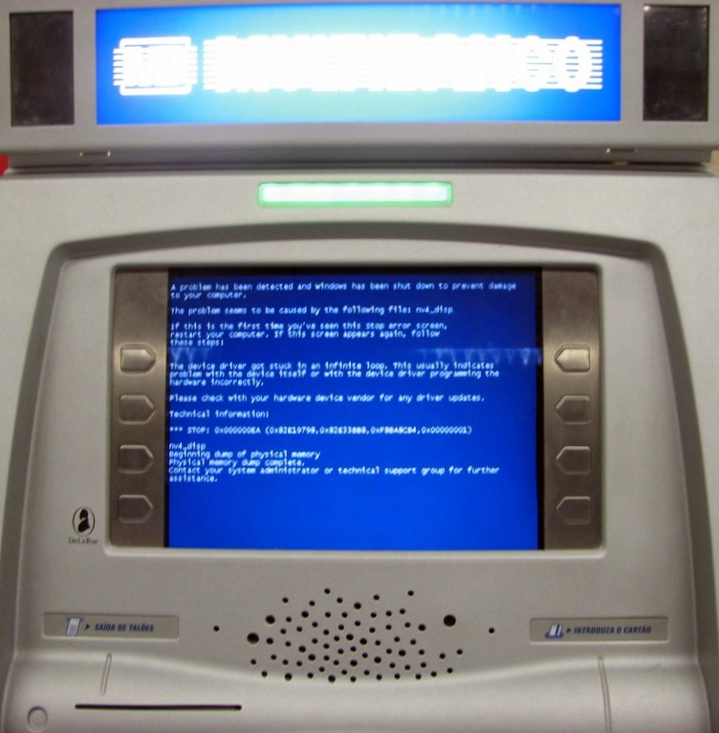
Multi Factor Authentication
Using More than One Authentication Factor

Slide 6
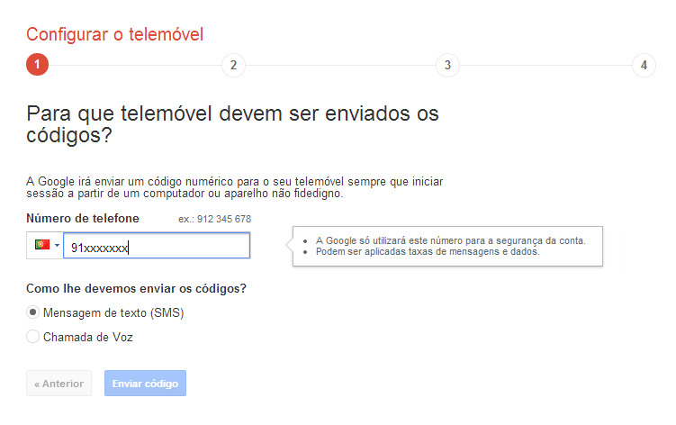
Our Solution
Base Function similar to Google Authenticator
Asking Password
Sending PIN code to Smartphone
Trusted Machine (Cookies)

Slide 7
Extending the Solution
Adapting to E-Commerce
Adress Distance Assessment
User buy history
Man In the Middle Mitigation
Dual PIN confirmation
HTTPS

Slide 8
Problems?
Intrusiveness
Clash with Amazon’s 1-Click Checkout or similar solutions
Cost
Sending SMS

Slide 9
Thank you!

